Slide 1


Slide 2
Agenda
Problem Statement 03
Data Mining - 01 04
Data Mining - 02 05
Exploratory Data Analysis (EDA) 06
Data Visualization 07
Algorithms Used 08
Analysis of Results 09
Conclusion & Future Work 10

Slide 3
Problem Statement
Credit Score Classification is one of the important aspects of the present world .
Credit Score is prediction of behaviour of credit card based on credit report of an individual .
As many bank advantages are based on Credit Score . Credit Score Calculation for an individual is Mandatory.
By this , the Problem Statement is
Credit Score Classification of people related to a particular bank based on the details of Number of loans ,Credit card number ,EMI etc.

Slide 4
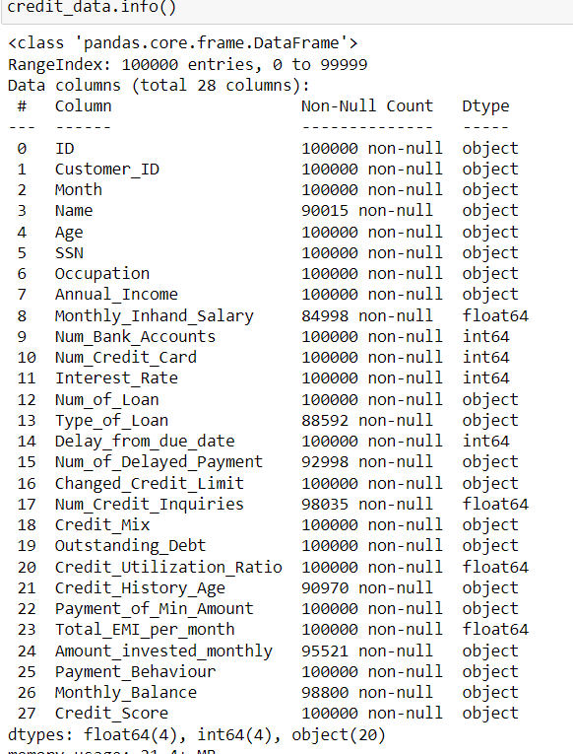
Data Mining - 01
Given dataset has Null values ad many Categorical variables
Given Dataset has 24 attributes and 20 attribute values .
We have used Simple Imputer to handle Null values .
Because Simple Imputer handles both Numeric and Categorical attributes .
After this we have only categorical attributes .

Slide 5
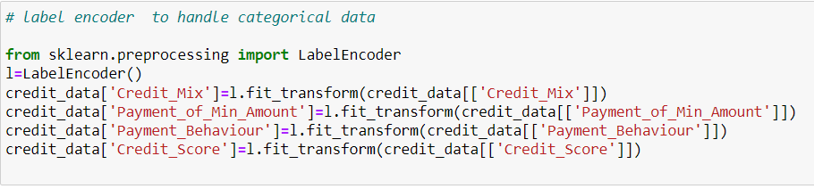
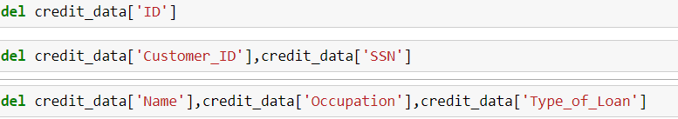
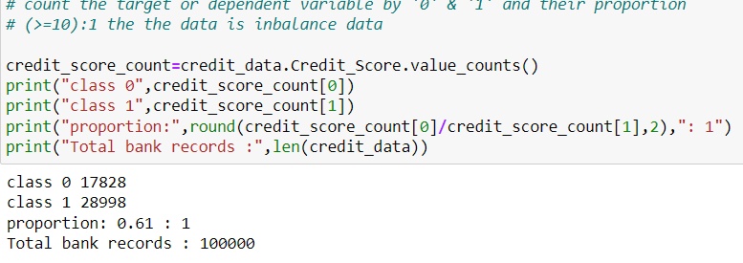
Data Mining - 02
Label Encoder is used to convert Categorical variables to Numeric variables .
Credit Mix ,Payment of Min Amount, Payment Behaviour , Credit Score[Target variable] are converted to numeric attributes .
Delete the attributes that does not affect our target variable .
The Dataset is a balance Dataset[0.61:1] .

Slide 6
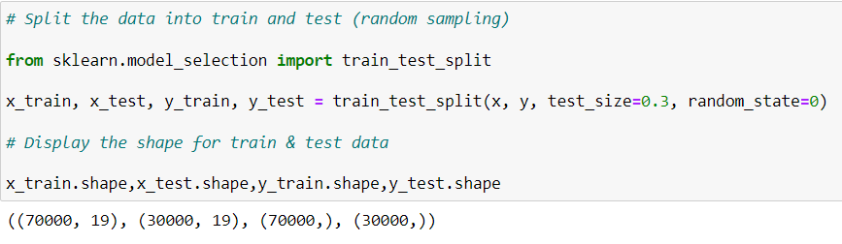
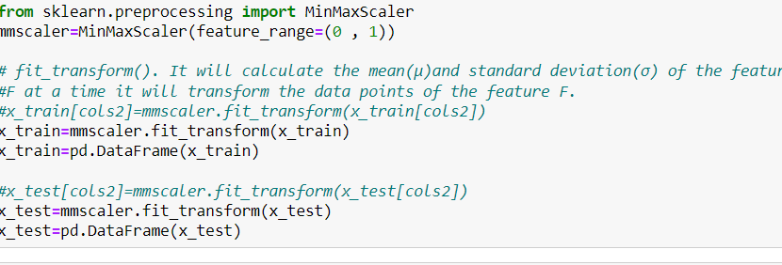
Exploratory Data Analysis (EDA)
Our Target Variable is “Credit_Score” and we split the data based on Independent and Target Variable .
We split our Dataset using the method train_test_split .
The two Datasets [x ,y] are of with Target and Independent Variables divided into train and test Datasets .
The Dataset is divided into Train and Test Datasets that are used to Discover algorithms and predict the values respectively .

Slide 7
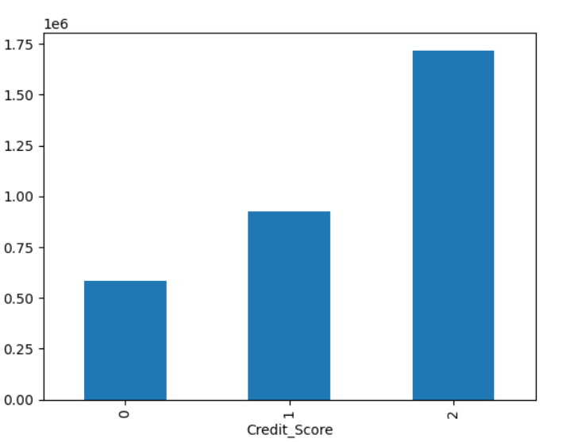
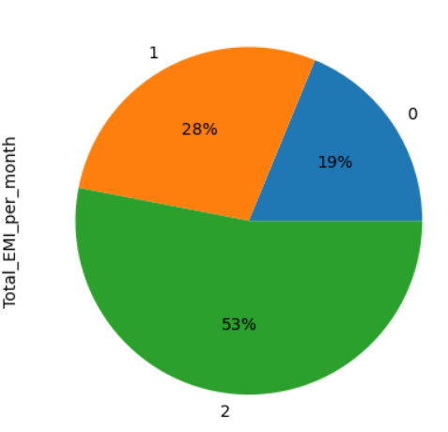
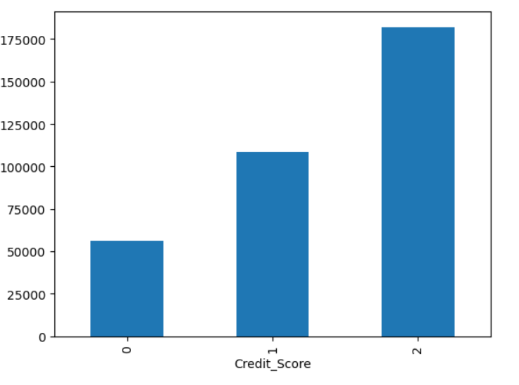
Data Visualization
Bar plot between “Credit_Score” and “Credit_Utilization_Ratio”,”Credit_Score”
and “Payment_Behaviour” .
Pie chart between “Credit_Score” and “Total_EMI_per_month” .

Slide 8
Algorithms Used
Problem is Multi Labelled Classification [Three Labels] .
We can use Six Algorithms for our Dataset . Those are
Logistic Regression
Decision Tree Classification
Extra Trees Classification
Random Forest
KNN Algorithm
Gaussian Bayes Classification
SVM algorithm will be slow because of our large Dataset[100000 rows]

Slide 9
Analysis of Results
Logistic Regression gives Accuracy of 61.3%
Decision Tree Classification gives Accuracy of 68%
Extra Tree Classification gives Accuracy of 74.7%
Random Forest Classification gives Accuracy of 77.5%
KNN Algorithm gives Accuracy of 66.8%
Gaussian Bayes Algorithm gives Accuracy of 60.9%

Slide 10
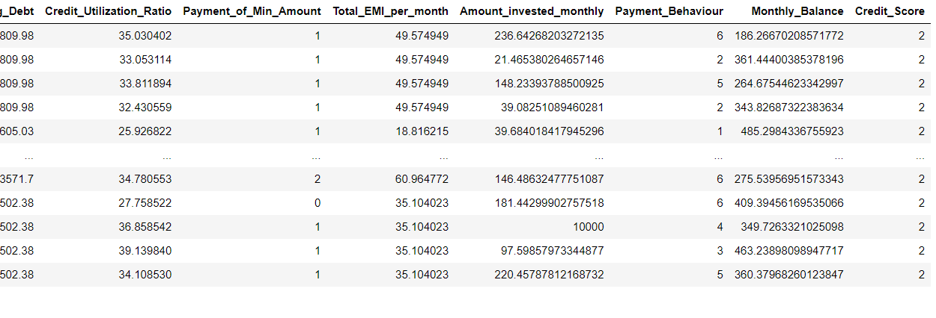
Conclusion and Future Work
We Predict the Algorithm using the validation dataset given .
From the above we got Accuracy 78% for Random Forest Algorithm .
So we take the Random Forest Algorithm to predict the result .
Using more techniques we will get more Accuracy by removing outliers .

Slide 11
Thank You
Q & A
Student Name : Sayani Sindu
Roll Number : 21B91A05S1
SRKR Engineering College
Mobile: +91 9014985249
Email: 21B91A05S1@srkrec.ac.in
Bhimavaram - India

